Slide 1
AIV ISSUES:
Incorrect process
AIV Environment
Missing on pickup and delivery positions
Replacing stoppers
Network issues
Omron/Intek

Slide 2
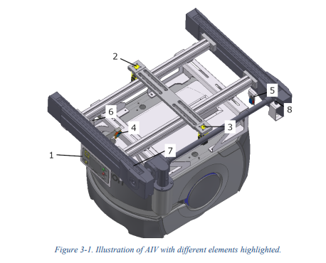
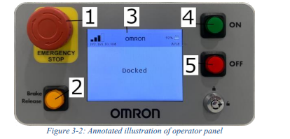
Inncorrect process
GO button
GO- Button
It was discovered that the AIVs had been 'operated' incorrectly for a long time. If an AIV stopped, an operator would double-click the GO button on the operator panel, and the AIV would drive off.
Why it shouldn't be done and why it leads to more problems:
The green GO button on the operator panel is a physical resume/start button for a task or movement.
Normal Function (Press once)
When pressed once:
- The robot acknowledges a pause/stop.
- It continues the task.
- It starts driving to the next target.
It is often used after a safety stop, a manual stop, or when the robot is waiting for confirmation.
When you double-click:
- The robot skips a waiting state.
This means that the robot does not stand still and wait for an expected event but moves on to the next step in the mission.
In most cases, when a robot stops in front of a conveyor belt, it is waiting for a signal from a sensor.
When you skip the waiting state, the fleet system assumes the job is complete.
Common consequences:
- Robot continues without a load
- Robot continues with a load but thinks it is empty
- Logistics errors
- Jobs that are never completed
- Queues in the system
- Robot drives unnecessary routes.
AIV sensors:
2. StopperRightDown - Inductive sensor that confirms that the stopper on the right side is down.
3. StopperLeftDown - Inductive sensor that confirms that the stopper on the left side is down.
4. SensorMIdPoint - Photocell that activates when a pallet covers the middle of the AIV.
5. ReflectorLeft - Photocell that looks after the reflector mounted on the cell. Confirm correct position. When doing pick up or deliveries on the left side of the AIV.
6. ReflectorRight - Photocell that looks after the reflector mounted on the cell. Confirm correct position. When doing pick up or deliveries on the right side of the AIV.
8. SensorPalettInPos - Inductive sensor that confirms that the pallet is in the correct position on the AIV.

Slide 3
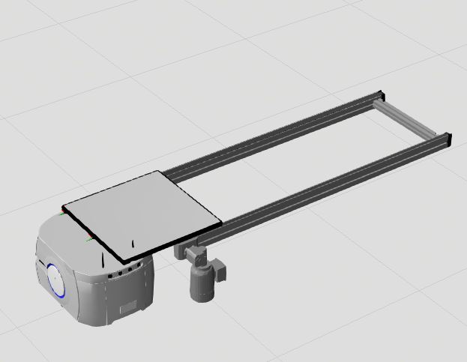
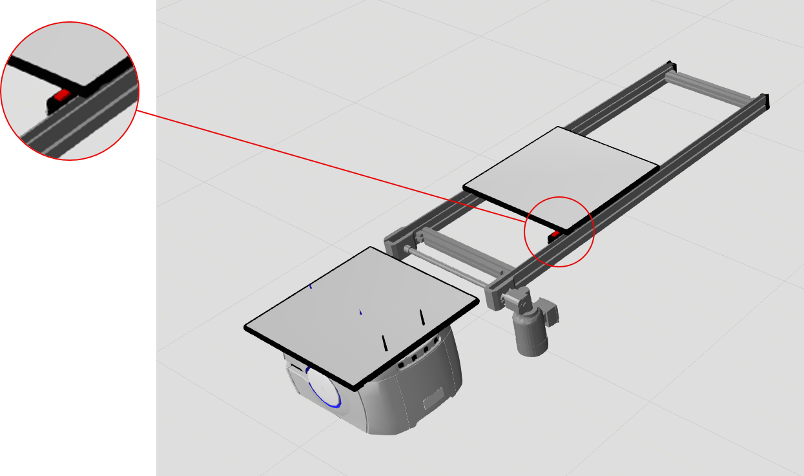
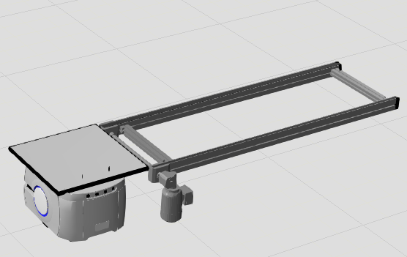
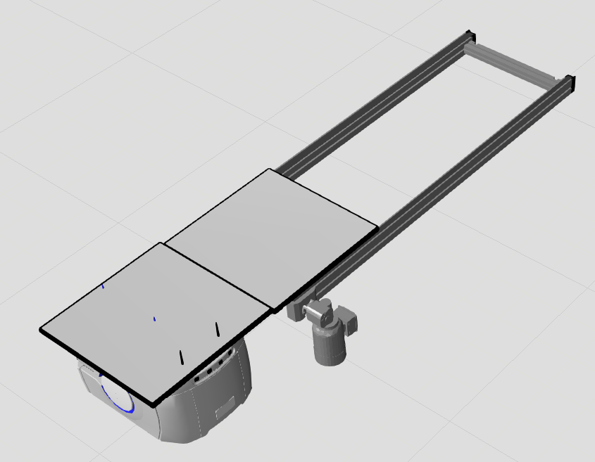
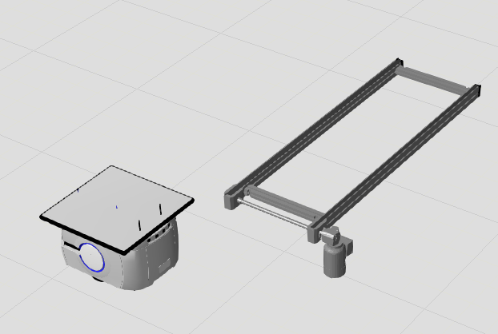
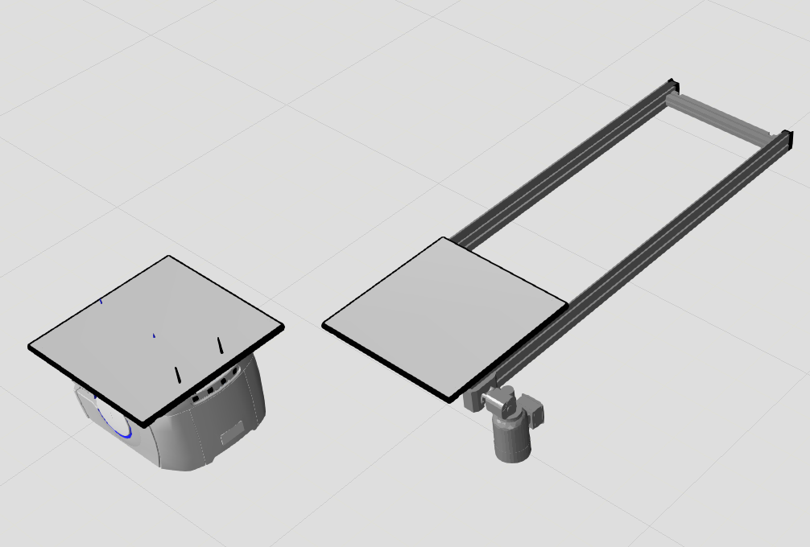
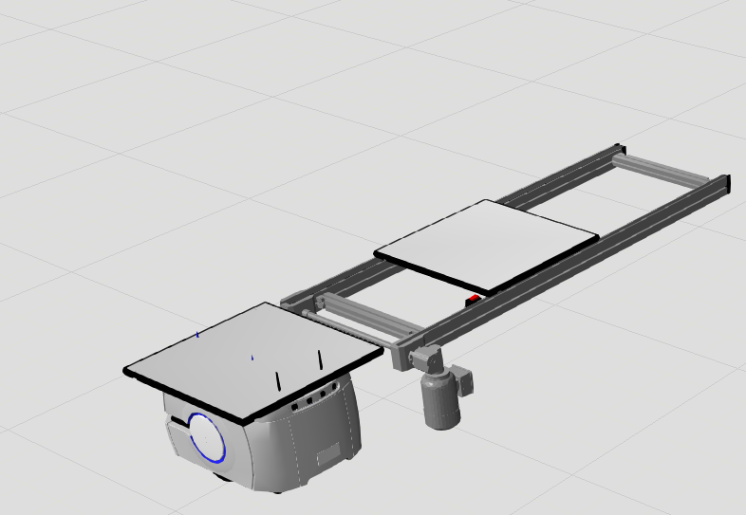
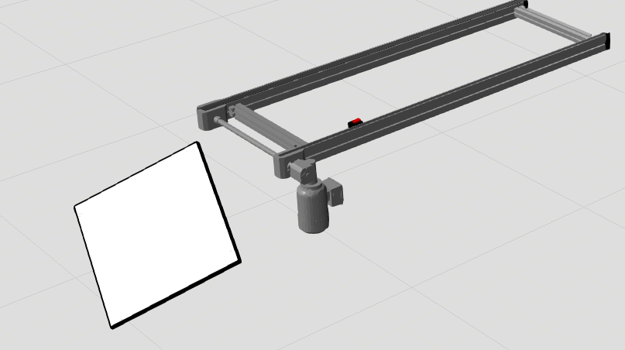
Inncorrect process
1. The AIV is found standing in front of the transport lane with half of the pallet delivered.
5. Since the AIV thinks it is empty, ReflectorRight will in this case signal the cell that the AIV is in position and ready to receive.
The cell will then open the stopper that prevents the pallet from being sent to the floor and start the conveyor to deliver the pallet.
2. The AIV was about to deliver the pallet to the conveyor, but the operator dragged the pallet back onto the AIV and double-clicked the GO button.
The AIV skips the wait state, which, in this case, is signaled by MidSensor and/or PalettInPos to confirm that the pallet has been delivered.
6. The pallet the cell is trying to deliver will stop when it hits the pallet that is already on the AIV and after a while a time out alarm will occur.
The AIV will stop because it is waiting for a signal from MidSensor and/or PalletInPos to confirm that the pallet has been received.
3. The AIV ​​thinks it is empty and drives away.
7. An operator finds the AIV stopped and double-clicks GO.
The AIV skips the wait state and continues.
The pallet that’s left on the conveyor has passed the stopper that prevents it from being dropped to the floor.
8. The next time the conveyor starts, the pallet falls to the floor.
4. The AIV gets a new pick-up job and drives to pick up a new pallet, even though it already has a pallet present.

Slide 4
Inncorrect process
Worst Case
This is a worst-case scenario that can happen when a double-clicker on GO on a stopped AIV.
The same happens if an AIV has received the pallet but has not received a sensor signal. The operator double-clicks on GO and the AIV, thinks it is empty, and continues.
Runs to pick up a new pallet.
Pallet stops in the pallet.
The operator double-clicks on GO.
Pallet falls to the floor.
Both examples have happened.
It can take several minutes from the time the operator double-clicks GO until the conveyor starts and the pallet falls to the floor.
The fact that the error occurs at two separate points in time makes it difficult to see the connection, and other causes of the error are reported.
The two examples here are the most serious, as they pose a potential danger to people near the conveyor and lead to damage to the pallet and product that falls to the floor.
Measures:
- Shiftlead and operator training and awareness.
The two examples rarely happen.
But what happens most often is:
- Fleet system marks the job as completed.
- New transport jobs that don't make sense.
- Multiple robots in the same location.
- Unnecessary traffic.
- Congestion in the transport system.
- Fleet manager loses optimization.
Bottom line:
It creates delayed errors that seem random. This can be frustrating and lead to many complaints.
It can look like '"the system did something weird on its own"
Even though the cause was a manual intervention earlier.
Then operators start to "fix" the system manually and you end up in a vicious circle.

Slide 5
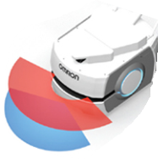
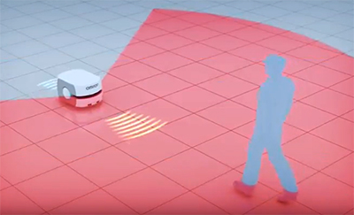
AIV Environment
Things that affect the robot’s behavior:
The AIVs navigate using laser-based mapping and sensors to orient themselves in their environment.
Things that interfere with the AIVs:
- Reflective surfaces can cause incorrect distance measurements.
* We have set up black screens in several places in the factory, intended to give the AIV a 'wall' to see.
On several occasions, various things have been placed in front of these walls.
- Obstacles in the laser zones will interfere with the AIV, causing it to slow down and create new routes to avoid the obstacle. This often results in the AIV taking a detour.
- Pallets and other objects are placed on the floor.
- Robot cables lying on the floor.
- People walking or standing in the laser zone.
These are common reasons for the many delays in the AIV flow.
Again, it can be experienced as if the AIV "makes mistakes on its own", or that the network is unstable without one thinking that it is because of the Carrier pallets that one has prepared by placing on the floor, or that one has placed pallets with empty blisters in front of the black screens.
SAFETY SCANNING LASER
Safety-rated laser for object detection and avoidance.
LOW FRONT LASER
Obstacle sensor detects low profile obujects when moving forward.
People present in the laser field will disturb the AIV.

Slide 6
Missing pickup and delivery positions
Things that affect delivery position:
- Uneven floor.
Damage and wear on the magnetic strips.
Dust on the LIDAR and safety scanner.
Dirty wheels.
- The magnetic strips wear down and need to be replaced at regular intervals.
- We have problems with the total weight of the AIV with load in some places becoming so high that the AIV wears down into the floor.
It creates holes in the floor that the AIV eventually gets stuck in. It also creates a lot of dust that can settle on the sensors and wheels, leading to wheel slip and navigation errors.
1. There is consistently heavy human traffic in the AIV lanes. There are many operators in the line, other employees and guests moving among the AIVs and disturbing them.
2. Cleaning of the floor in the factory in general has become poor, which leads to a lot of dust and dirt that settles on the AIV wheels.
The guide lanes in front of the conveyor are not cleaned. Here, most of the dust and dirt from the floor is worn down, which in turn settles on the wheels and sensors.
3. General cleaning of the AIV is poor.
Bottom line:
Double-clicking the OG-button, foreign objects placed on the floor, human traffic, dirty AIV’s, and floor Are the main reasons why AIVs do not function optimally.
- They take detours.
- They slow down or stop.
- They miss pickup and drop-off locations.
- Transport jobs that do not make sense.
Queues in the transport system.
Measures:
Shiftlead and operator training and awareness.
Increase the overall understanding of how the AIV’s operate and what affects them.
Training in troubleshooting and root cause analysis.
Focus on keeping the floor clean and tidy.

Slide 7
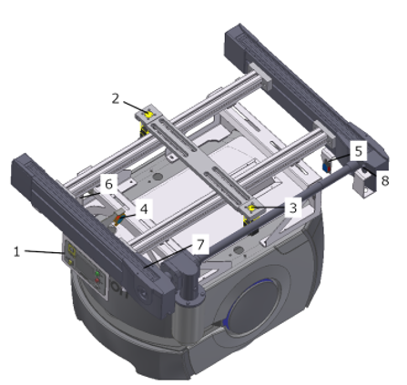
Replacing stoppers
The main reasons for AIV’s are taken out of production is:
Sensor fault.
Bent or broken stopper.
A broken or loose sensor is often the reason the AIV starts behaving strangely.
It becomes frustrating for the AIV to stop so often. This results in the AIV being deactivated and put aside. Usually without knowing why.
In the last year and a half, we have had a sharp increase in stoppers that need to be replaced because they have been bent and in some cases broken right off.
- If the MIdSensor is bad and the signal is not received, it happens that the AIV does not lower the stopper when it is supposed to, and the pallet is sent straight into the stopper, so it takes a little hit. If this happens enough times, the cylinder on the stopper can be bent or a small splinter can be knocked out, causing the stopper to get stuck.
The main reason why the stoppers need to be replaced is that the operator is too rough when they have to pull the pallet onto the AIV. Then they pull the pallets hard into the stopper.
A significant increase in stoppers that need to be replaced, and long delivery times have resulted in AIV being out of order for a longer period of time.
Measures:
Shiftlead and operator training and awareness.
Training in troubleshooting and root cause analysis.
Training in using our system to troubleshoot and test the sensors.
In talks with Intek about getting more robust stoppers.

Slide 8


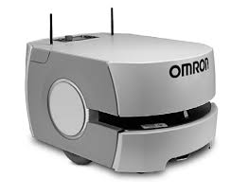
Network issue:
Network issues
Network problems:
It has been an exaggerated problem that has led to misunderstandings and frustration.
There is rarely talk of problems with the network.
- What happens 9 times out of 10 is that there is interference on the 2.4 GHz frequency.
- This causes the AIVs to lose the Wi-Fi signal.
- When all the AIVs try to reconnect at the same time, it becomes too much.
The solution is to turn off the AIVs and start them up a few at a time.
- Everything in the factory is on the 2.4 GHz.
- The AIVs are only compatible with 2.4 GHz.
- Possibility to move other equipment and Wi-Fi networks to the 5Ghz frequency.
Measures:
-. Shiftlead and operator training and awareness.
- Increased understanding of how the AIVs work.
- Training in how to ping the AIVs to see the load and traffic.
Enterprise Manager
Wi-Fi
AIV
Ethernet
Linjenett

Slide 9
Network issue:
Omron/Intek
Omron/Intek
Sometimes the AIV coming from Cell2 (203) delivering to Cell4 (403) miss the delivery path by 1,5meters.
It’s only the AIV carrying the pallets from Cell2 this happens to.
It’s always the same place it ends up when it misses the delivery path.

