Slide 1
Python API in NG
What’s new in NG
6 / 2 / 2016 - Samuli Ahonen
Webinar link: https://attendee.gotowebinar.com/register/1716299542769799681

Slide 2
Command Registration
Localizing commands
Action Panel
Selection & Context
Pick / Snap

Slide 3
Command Registration

Slide 4
Command registration
More freedom adding menu items
Custom buttons in
ribbon tabs
context menus
quick menus
...

Slide 5
Home ribbon
cmduri = getApplicationPath() + 'hello.py'
cmd = loadCommand('cmdHello', cmduri)
addMenuItem(“VcTabHome/VcRibbonShow”, "say hello", -1, “cmdHello")

Slide 6
Home ribbon
addMenuItem(“VcTabHome/My group”, "say hello", -1, “cmdHello")

Slide 7
Drawing ribbon
addMenuItem("VcTabDrawing/My group", "say hello", -1, "cmdHello")

Slide 8
Program ribbon
addMenuItem("VcTabTeach/My group", "say hello", -1, "cmdHello")

Slide 9
Modeling ribbon
addMenuItem("VcTabAuthor/My group", "say hello", -1, "cmdHello")

Slide 10
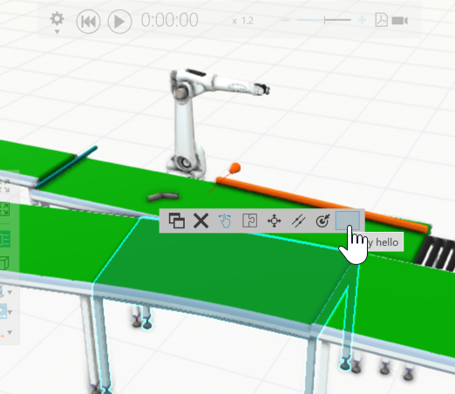
Quick menu
addMenuItem("VcConfigureQuickmenu", "say hello", -1, "cmdHello")

Slide 11
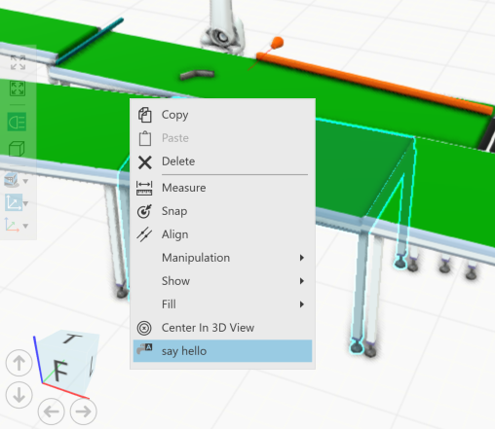
3d context menu
addMenuItem("VcConfigure3DContextMenu", "say hello", -1, "cmdHello")
addMenuItem("VcTeach3DContextMenu", "say hello", -1, "cmdHello")
addMenuItem("VcDrawing3DContextMenu", "say hello", -1, "cmdHello")
addMenuItem("VcAuthor3DContextMenu", "say hello", -1, "cmdHello")

Slide 12
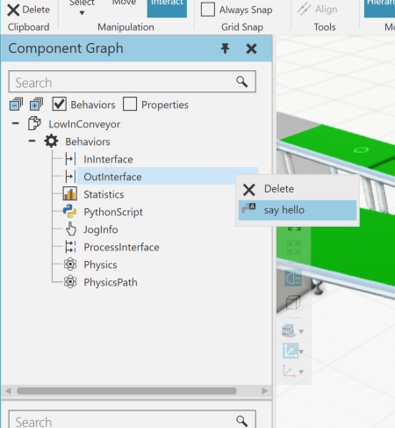
Component graph Tree context menu
addMenuItem("VcAuthorTreeViewContextMenu", "say hello", -1, "cmdHello")
addMenuItem("VcAuthorTreeViewBehaviorsContextMenu", "say hello", -1, "cmdHello")
addMenuItem("VcAuthorTreeViewPropertiesContextMenu", "say hello", -1, "cmdHello")
addMenuItem("VcAuthorTreeViewRobotFramesContextMenu", "say hello", -1, "cmdHello")
addMenuItem("VcAuthorTreeViewFeaturesContextMenu", "say hello", -1, "cmdHello")
addMenuItem("VcAuthorTreeViewNodesContextMenu", "say hello", -1, "cmdHello")
addMenuItem("VcAuthorTreeViewToolContextMenu", "say hello", -1, "cmdHello")
addMenuItem("VcAuthorTreeViewBasesContextMenu", "say hello", -1, "cmdHello")

Slide 13
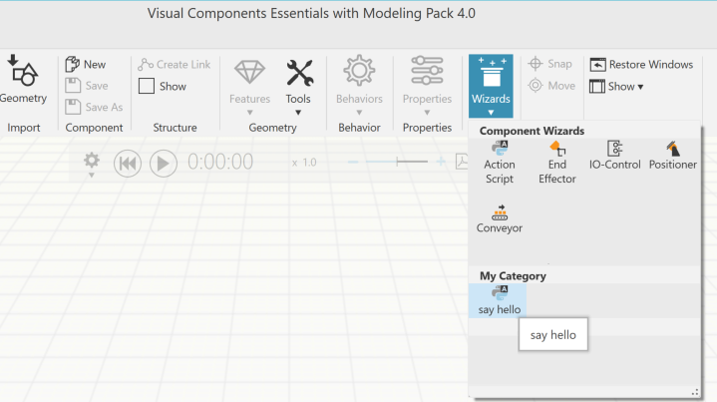
gallery
addMenuItem(VC_MENU_MODELING_WIZARDS + "/My Category", "say hello", -1, "cmdHello")

Slide 14
documentation
Not yet fully documented ☹
Use the config file as raw doc ☺
C:\Program Files\Visual Components\Visual Components Essentials with Modeling Pack 4.0\VisualComponents.Essentials.exe.config
Find examples in the python command installation folder ☺
C:\Program Files\Visual Components\Visual Components Essentials with Modeling Pack 4.0\Python\VisualComponents\FeatureTreeTools
C:\Program Files\Visual Components\Visual Components Essentials with Modeling Pack 4.0\Python\VisualComponents\Wizards

Slide 15
Action Panel

Slide 16
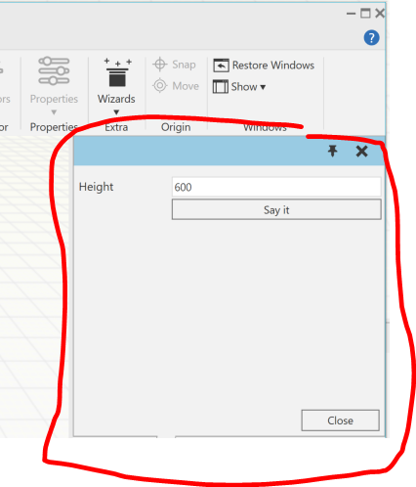
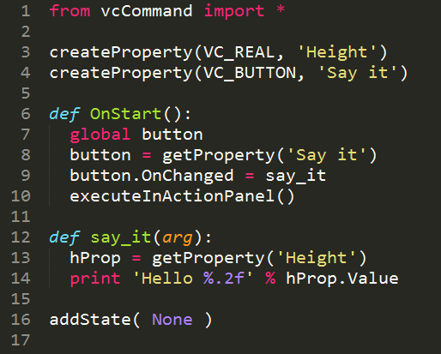
Using action panel with commands
Create properties to the command
executeInActionPanel()
Properties flagged visible are shown in the action panel

Slide 17
Localizing commands

Slide 18
Localize GUI
Localize
Command names (”Text”)
Tooltips (”Tooltip”)
GUI Icons (”Icon”)

Slide 19
Localize properties
Localize
property names
tooltips
Localize before creating the property

Slide 20
Selection and Context

Slide 21
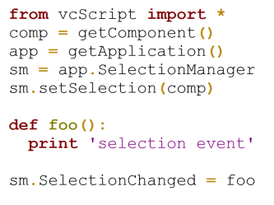
Selection
New Selection manager in python API
vcApplication.SelectionManager
Use this instead of
app.getSelection( ... )
app.CurrentSelection

Slide 22
Context
Context controls
What can be selected in 3D
What panels are shown and where
VC_CONTEXT_CONFIGURE = “Configure“
VC_CONTEXT_DRAWING = "Drawing“
VC_CONTEXT_TEACH = "Teach“
VC_CONTEXT_AUTHOR = "Author"

Slide 23
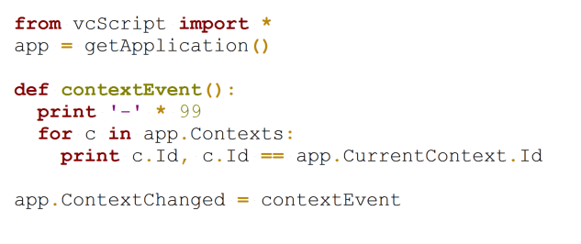
Context
Python API
Access all available contexts
Set and get active context
Event for context change
Access active objects in context

Slide 24
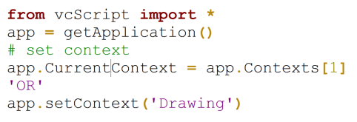
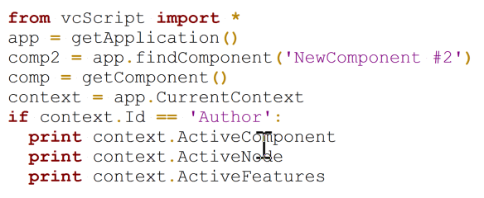
Context
Set the active context
Access active objects

Slide 25
Snap

Slide 26
Snap command
Interface same as in 2014 but with small additions
cmd. SnapOnBoundType
cmd.clear()
Improved control for highlighting

Slide 27
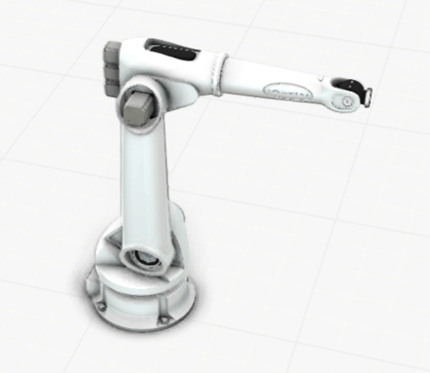
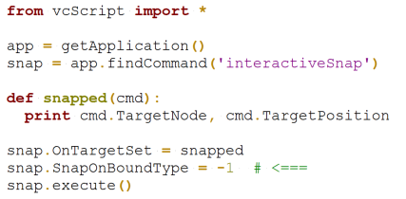
Snap command
SnapOnBoundType

Slide 28
Cherry on the cake

Slide 29
Recompiling python commands
No need to recompile commands manually
Save the .py file and execute the command again
The command is automatically recompiled

